Slide 1
Movie Recommendation System
DATS 6202 Group Project
Max, Michael, Yaswanth

Slide 2
Dataset Overviews
Dataset | Dataframe Size | Columns
movies_metadata | (45,466, 24) | 'adult', 'belongs_to_collection', 'budget', 'genres', 'homepage', 'id', 'imdb_id', 'original_language', 'original_title', 'overview', 'popularity', 'poster_path', 'production_companies', 'production_countries', 'release_date', 'revenue', 'runtime', 'spoken_languages', 'status', 'tagline', 'title', 'video', 'vote_average', 'vote_count'
keywords | (46,419, 2) | 'id', 'keywords'
links | (45,843, 3) | 'movieId', 'imdbId', 'tmdbId'
links_small | (9,125, 3) | 'movieId', 'imdbId', 'tmdbId'
ratings_small | (100,004, 4) | 'userId', 'movieId', 'rating', 'timestamp'

Slide 3
Movie Recommendation System Structure
Model Components
Predicting Movie Popularity
Recommended Movies
Rank By:
Rating
Movie Similarity Clustering
Genre
Production
Topic
NLP

Slide 4
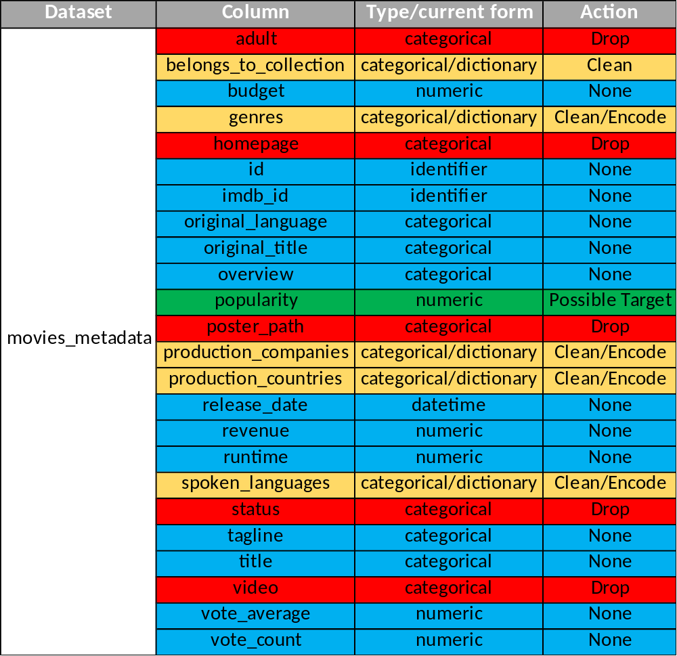
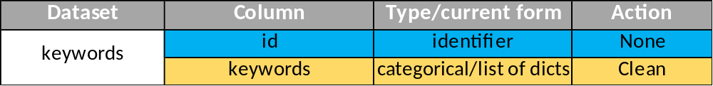
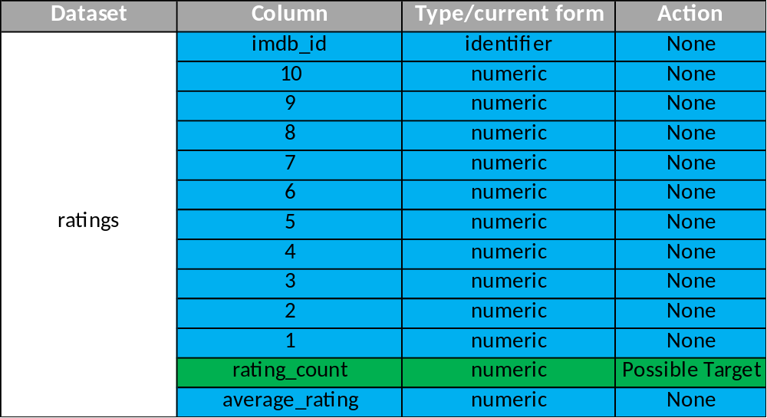
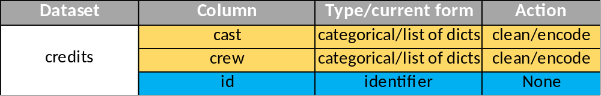
Prepping Data

Slide 5
Predicting Movie Popularity
Linear Regression
Genre
Budget
Original Language
Production Company
Production Country
Release Date
Revenue
Average Rating
Popularity
Rating Count
Spoken Language
Neural Network
Cast
Crew
Keywords

Slide 6
Metrics for Movie Similarities
Base recommendation on similarity to searched movie:
Genre
Recommended Movies
Cast
Production Company
Production Country
Rank By:
Rating
Popularity
Production Similarity
  Key words
  Tagline
  Description
  Belongs to collection
Topic Similarity

Slide 7
Clustering Movies by Similarity

